Slide 1

Software requirements (swr302)
Finding the voice of the users (chapter 06)

Slide 2
Finding the voice of the user
Success in software requirements, and hence in software development, depends on getting the voice of the user close to the ear of the developer
Steps to find the voice of the user
Identify the different classes of users for your product
Select and work with individuals who represent each user class and other stakeholder groups
Agree on who the requirements decision makers are for your project.
Customer involvement is the best way to avoid the expectation gap a mismatch between the product that customers expect to receive and what developers build
The features that users present as their “wants” don’t necessarily equate to the functionality they need to perform their tasks with the new product

Slide 3
User Classes Classifying Users
You can group users into a number of distinct user classes based on these sorts of differences:
Their access privilege or security levels (such as ordinary user, guest user, administrator)
The tasks they perform during their business operations
The features they use
The frequency with which they use the product
Their application domain experience and computer systems expertise
The platforms they will be using (desktop PCs, laptop PCs, tablets, smartphones, specialized devices)
Their native language
Whether they will interact with the system directly or indirectly

Slide 4
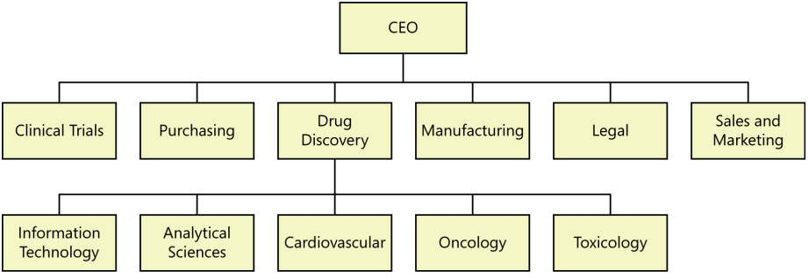
User Classes Identifying user classes for your project
A useful technique for this is a collaboration pattern
Ask the for the list of people who he expects to use system
Brainstorm as many user classes as you can think of
Look for groups with similar needs that you can either combine or treat as a major user class with several subclasses
The external entities shown outside your system on a context diagram are candidates for user classes.
A corporate organization chart can also help you discover potential users and other stakeholders

Slide 5
User Personas
A persona is a description of a hypothetical, generic person who serves as a stand-in for a group of users having similar characteristics and needs.
Using personas understand the requirements and to design the user experience to best meet the needs of specific user communities.
Working with a persona makes the requirements thought process more tangible than if you simply contemplate what a whole faceless group of people might want. Some people choose a random human face of the appropriate gender to make a persona seem even more real.
Notes:
Hypothetical: giả định
Contemplate: thưởng ngoạn

Slide 6
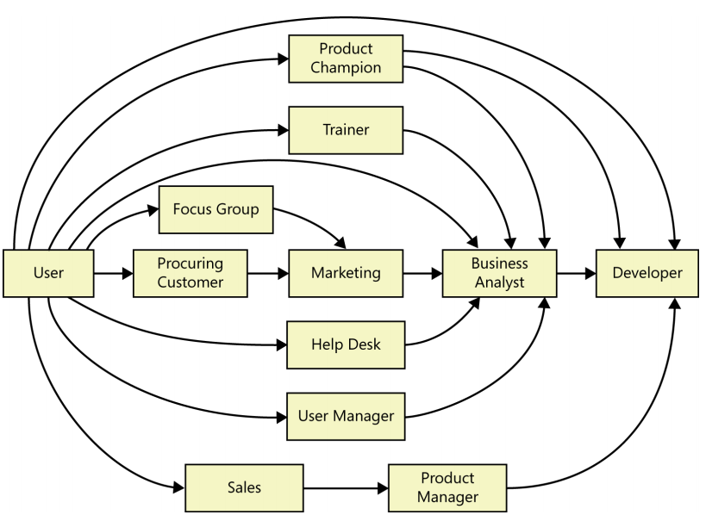
Connecting with user representatives
Typical communication pathways between users and developers

Slide 7
Product champion
Definition: product champions?
Product Champions are few key members of our user community to provide the requirement
Each product champion serves as the primary interface between members of a single user class and the project’s BA
When developing commercial software, it can be difficult to find product champions from outside your company
Internal subject matter experts or outside consultants
Hire a suitable product champion who has the right background
Notes:
What does the product champion do?
Gather requirements from other members of the user classes they represent and reconcile inconsistencies
They have a clear vision of the new system. They’re enthusiastic because they see how it will benefit them and their peers
Great product champions are in demand for other assignments, so you’ll have to build a persuasive case for why particular individuals are critical to project success
Anytime the product champion is a former or simulated user, watch out for disconnects between the champion’s perceptions and the current needs of real users

Slide 8
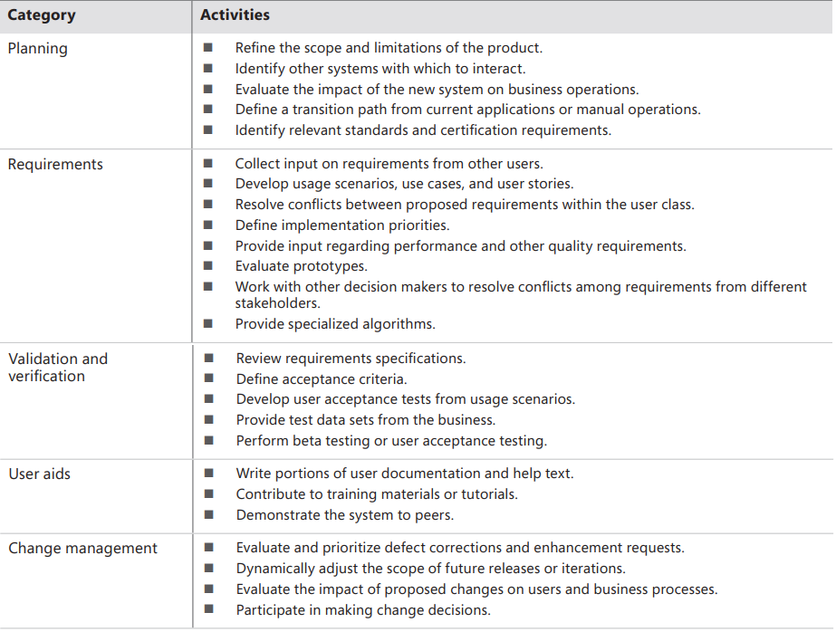
Product champion Product champion expectations

Slide 9
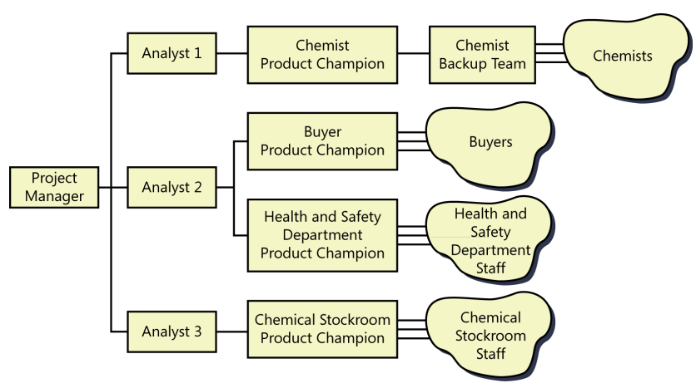
Product champion Multiple Product Champions
One person can rarely describe the needs for all users of an application. We need multiple product champions for major user classes

Slide 10
User representation on agile projects
Product owner
Frequent conversations
Product owner vs. product champion
An on-site customer doesn’t guarantee the desired outcome

Slide 11
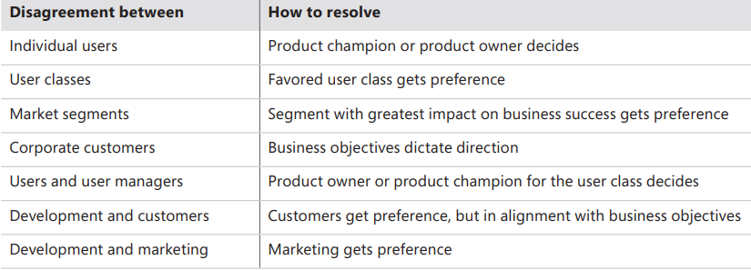
Resolving conflicting requirements

Slide 12


